Slide 1

UDPS 2133 Mathematical Programming
Topic 1:
Nonlinear Programming

Slide 2
Nonlinear Programming
Unconstrained
Constrained
Line Search
Multidirectional Search
Transformation
Direct Search Method
Without Derivative
With Derivative
Without Derivative
With Derivative
Golden Section Search
Fibonacci Method
Bisection Method
Newtown Method
Secant Method
Nelder Mead Simplex
Hooke & Jeeves
Rosenbrock
Steepest Ascent
Newton Method
Quasi Newton Method
DFP
BFGS
Lagrange Multiplier
Penalty Function
Barrier Function
Feasible Direction Method
Karush-Kuhn- Tucker condition (KKT)
Notes:
Without derivative → derivative may not known
DFP = David Fletcher Powell
BFGS = Broyden Fletcher Goldfarb Shanno

Slide 3
NLP
1 Variable
Quadratic Programming
Several Variable
Separable Programming
Golden Section Search
Feasible Direction Method
Pareto Optimality and Tradeoff Curves
Steepest Ascent
Unconstraint
Karush-Kuhn-Tucker
Lagrange Multipliers
Constraint

Slide 4
Review
Linear programming:-
Max/min linear function s.t. linear constraints
Objective function may not be a linear function
or
Some of the constraints may not be linear constraints
Nonlinear programming problem (NLP)

Slide 5
Review
Basic knowledge:-
Limits
Continuity
Differentiation
Partial Derivative

Slide 6
Review
Limits
Show that
x | 1.8 | 1.85 | 1.9 | 1.99 | 1.9999
f(x) | −0.36 | −0.2775 | −0.19 | −0.0199 | −0.0001999
Notes:
To verify this result, evaluate x² − 2x for values of x close to, but not equal to, 2.

Slide 7
Review
Continuity
For all values of x, determine if f (x) is continuous or discontinuous
f (x) = 25x for 0 ≤ x < 100
f (x) = 20x for 100 ≤ x ≤ 200
f (x) = 15x for x > 200
f(x) is discountinuous at x = 100 and x = 200 beacuse
and do not exist, and
f(x) is countinuous for all other values of x satisfying x ≥ 0.

Slide 8
Review
Differentiation
If a company charges a price p for a product, then it can sell 3000e^{−p} units of the product. Then, f(p) = 3,000pe^{−p} is the company’s revenue if it charges a price p.
For what values of p is f (p) decreasing? For what values of p is f(p) increasing?
f '(p) = −3,000pe^{−p} + 3,000e^{−p} = 3,000e^{−p}(1 − p)
For p < 1, f '(p) > 0 and f(p) is increasing.
For p > 1, f '(p) < 0 and f(p) is decreasing.

Slide 9
Review
Partial Derivative
The demand f (p, a) = 30,000p⁻²a^{1/6} for a product depends on product price, p (in dollars) and dollars spent advertising the product, a.
Is demand an increasing or decreasing fn of price?
Is demand an incr or decr fn of advertising expenditure?
Thus, an increase in price (with advertising held constant) will decrease demand, while an increase in advertising (with price held constant) will increase demand.

Slide 10
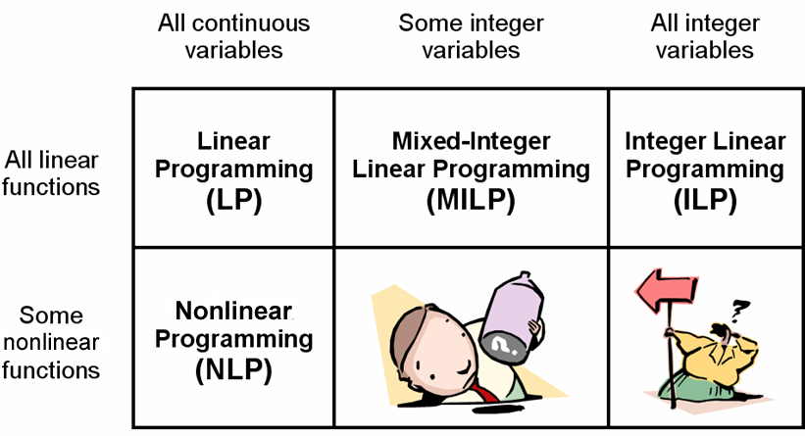

Slide 11
NLP?
NLP’s are closer to general and realistic (and possibly unsolvable) models than the LP’s. Some LPs are the linearized versions of NLPs out of necessity.
NLP’s have non-proportional and non-additive (multiplicative) relationships.

Slide 12
NLP
Any point x_{j} in the feasible region for which f (x_{j}) ≥ f (x) holds for all points x in the feasible region is an optimal solution to the NLP. [For a minimization problem, x_{j} is the optimal solution if f (x_{j}) ≤ f (x) for all feasible x.]
Find values of decision variables x₁, x₂,…, x_{n} that
max (or min) z = f(x₁, x₂,…, x_{n})
s.t. g₁(x₁, x₂,…, x_{n}) (≤, =, or ≥) b₁
g₂(x₁, x₂,…, x_{n}) (≤, =, or ≥) b₂
⁞
g_{m}(x₁, x₂,…, x_{n}) (≤, =, or ≥) b_{m}
Objective Function
Constraints
Feasible Region (Set of points)

Slide 13
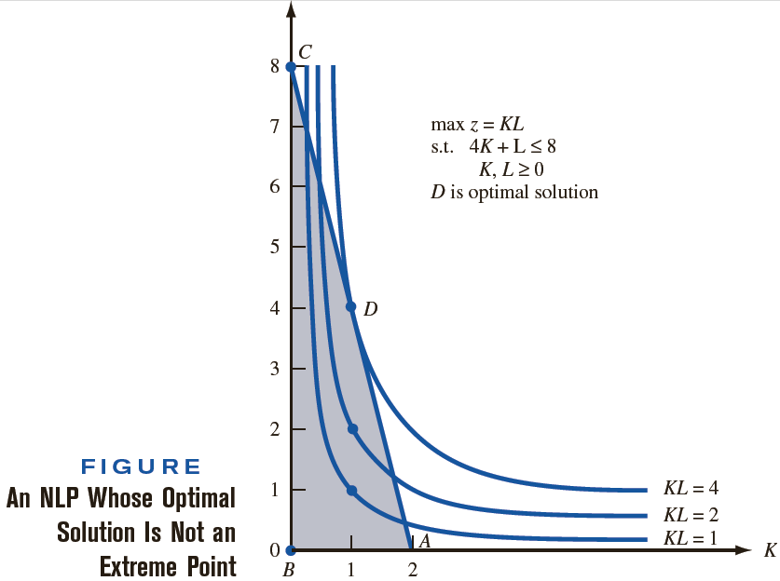
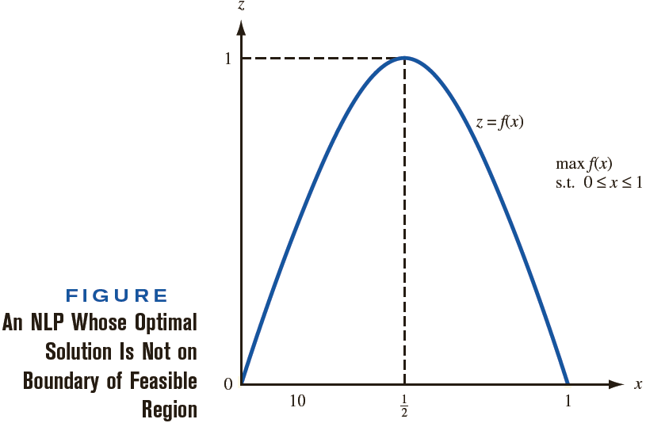
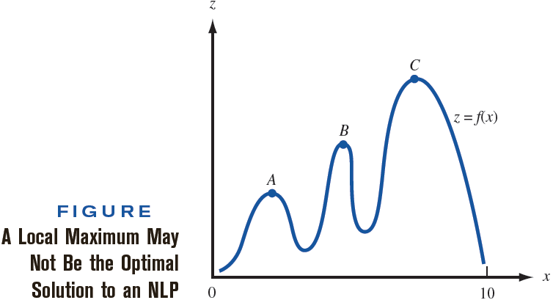
Differences
Example:
Linear Programming
Linear function
Feasible region is a convex set
Optimal solution is an extreme point of the feasible region
Local maximum is an optimum solution
Nonlinear Progmmg.
Nonlinear function
Feasible region can be convex / concave
Optimal solution need not to be extreme point
Local maximum need not to be optimum solution
Next slide
Notes:
feasible region (bounded by triangle ABC)
isoprofit curves KL=1, KL=2, and KL=4
Optimal solution to the example occurs where an isoprofit curve is tangent to the boundary of the feasible region.
optimal solution to the example is z =4, K =1, L=4 (point D). Of course, point D is not an extreme point of the NLP’s feasible region.
the optimal solution fails to be an extreme point of the feasible region because the isoprofit curves are not straight lines. In fact, the optimal solution for an NLP may not be on the boundary of the feasible region.
Max z = f (x) s.t. 0 ≤ x ≤ 1
The optimal solution for this NLP is z =1, x =1/2. Of course, x =1/2 is not on the boundary of the feasible region.
Points A, B, and C are all local maxima, but point C is the unique optimal solution to the NLP.

Slide 14
Differences
f (x₁, x₂, . . . , x_{n}) is a convex fn iff −f (x₁,x₂, . . . , x_{n}) is a concave fn, and conversely.
Convex Function
Convex set: If A and B are feasible, the entire line AB also feasible.
f [cx′+(1−c)x″] ≤ cf (x′) + (1− c)f (x″) for 0≤ c ≤ 1 where x′, x″ ∈ S (convex set)
Concave Function
Non-convex set: If A and B are feasible, the entire line AB might not be feasible
f [cx′+(1−c)x″] ≥ cf (x′) + (1− c)f (x″) for 0≤ c ≤ 1
x
x'
two convex sets
non-convex set

Slide 15
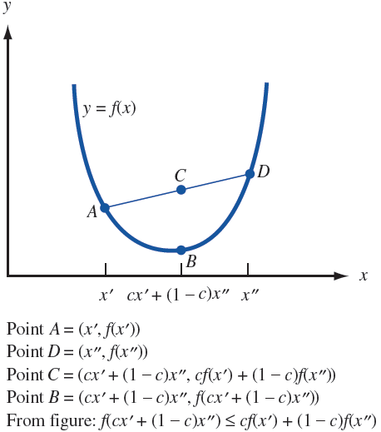
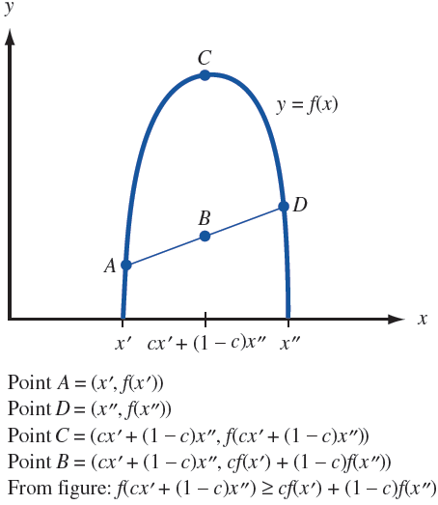
Differences
f(x) is convex iff the line segment joining any 2 points on the curve y = f (x) is never below the curve y = f (x).
f(x) is concave iff the line segment joining any 2 points on the curve y = f (x) is never above the curve y = f (x).
Convex Function
Concave Function

Slide 16
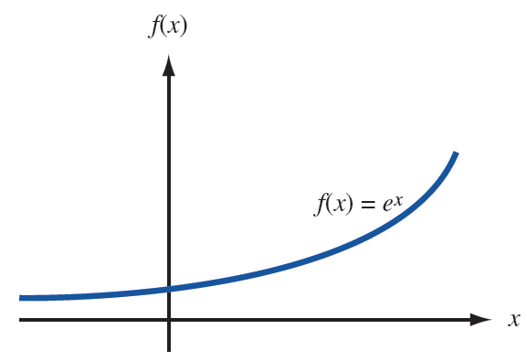
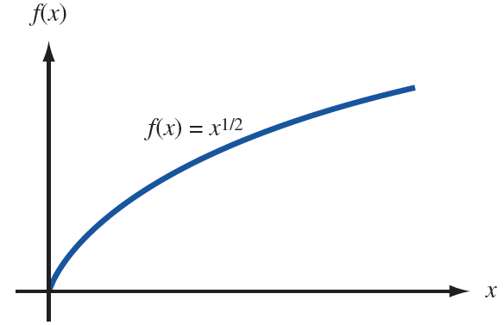
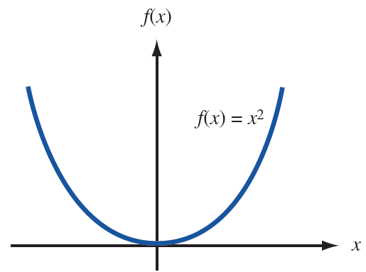
Convex and Concave functions
Examples:
Convex ?
Concave?
Notes:
1st : Convex
2nd : Convex
3rd : Concave

Slide 17
Convex and Concave functions
**A linear function of the form f(x) = ax + b is both a convex and a concave function. This follows from
f [cx′+(1−c)x″] = a[cx′ + (1− c)(x″)] + b
= c(ax′ + b) + (1− c)(ax″ + b)
= cf(x′) + (1−c)f(x″)

Slide 18
Hessian Function
Use to determine convex/concave
Convex Set
Suppose f (x₁, x₂, . . . , x_{n}) has continuous second-order partial derivatives for each point x = (x₁, x₂, . . . , x_{n}) ∈ S.
Convex Function
f (x₁, x₂, . . . , x_{n}) is a convex fn on S iff for each x ∈ S, all principal minors of H are positive.
Concave Function
f (x₁, x₂, . . . , x_{n}) is a concave fn on S iff for each x ∈ S and all nonzero principal minors have the same sign as (−1)^{k}, k = 1, 2, . . . , n
An i^{th} principal minor of an n×n matrix is the determinant of any i×i matrix obtained by deleting n−i rows and the corresponding n−i columns of the matrix.

Slide 19
Hessian Function
Hessian of f (x₁, x₂, …, x_{n}) is the n × n matrix whose ij^{th} entry is .

Slide 20
Hessian Function
!!! Both 1st minor must be same sign, otherwise, 2nd minor will always be in negative sign, then the function is neither convex nor concave !!!
Determinant:
ad – bc
1st minor | 2nd minor | Function
+ve | +ve ( > 0 ) | Convex (min)
+ve | −ve ( < 0 )
+ve / −ve | = 0 | Convex / Concave
−ve | +ve ( > 0 ) | Concave (max)
−ve | −ve ( < 0 )
Not concave
Notes:
first principal minors are −2 and −4, non-positive
second principal minor is −2(−4) − (−1)(−1) = 7 >0
∴Concave function
2nd minor < 0, we have saddle point

Slide 21
Local Extremum
For any NLP (maximization), a feasible point x = (x₁, x₂, . . . , x_{n}) is a local maximum if for sufficiently small ϵ, any feasible point
x′ = (x′₁, x′₂, . . . , x′_{n}) having
|x_{i} − x′_{i} |< ϵ (i = 1, 2, . . . , n) satisfies f (x) ≥ f (x′).
A point that is a local maximum or minimum also called local, relative, extremum

Slide 22
Unconstraint NLP

Slide 23
Solving NLP with 1 variable
Solve NLP: max (min) f(x) s.t x ∈ [a, b]
3 type of extremum candidates (local max or min point for NLP)
CASE 1: a < x < b & f '(x) = 0 exist
CASE 2: f '(x) doesn’t exist
CASE 3: Endpoints of the interval [a, b]
stationary pt
Notes:
To find the optimal solution for the above NLP, we find all local maxima (or minima). A point that is a local maximum (or minimum) is called a local extremum. Then the optimal solution is the local maximum (or minimum) having the largest (or smallest) value of f (x). If a =− ∞ or b = ∞, then NLP may have no optimal solution.

Slide 24
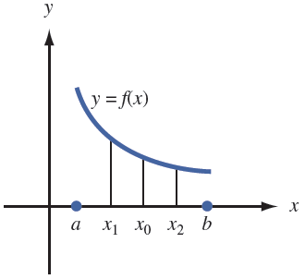
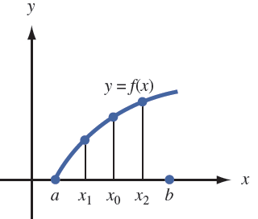
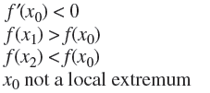
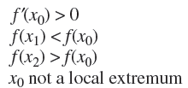
Solving NLP with 1 variable
Solve NLP: max (min) f(x) s.t x ∈ [a, b]
CASE 1:
a < x < b

Slide 25
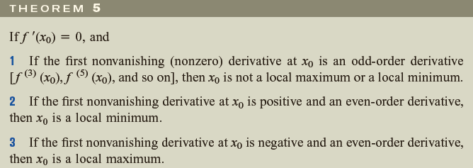
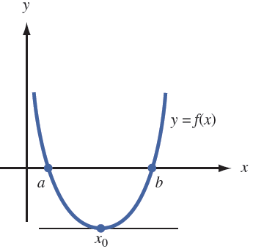
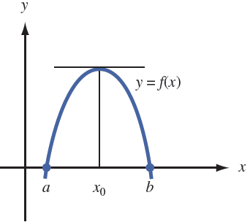
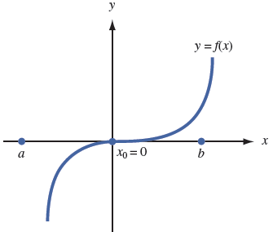

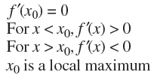

Solving NLP with 1 variable
Solve NLP: max (min) f(x) s.t x ∈ [a, b]
CASE 1:
f '(x) = 0

Slide 26
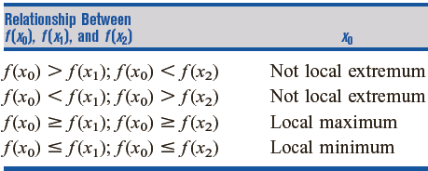
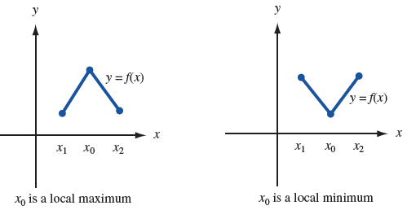
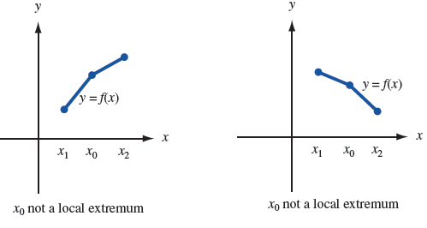
Solving NLP with 1 variable
Solve NLP: max (min) f(x) s.t x ∈ [a, b]
CASE 2: f '(x) doesn’t exist

Slide 27
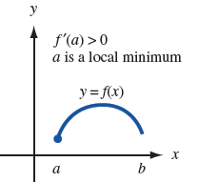
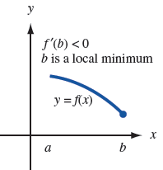
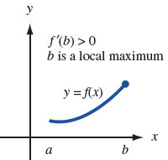
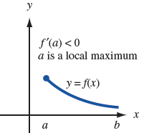
Solving NLP with 1 variable
Solve NLP: max (min) f(x) s.t x ∈ [a, b]
CASE 3: End pints a and b of interval [a, b]

Slide 28
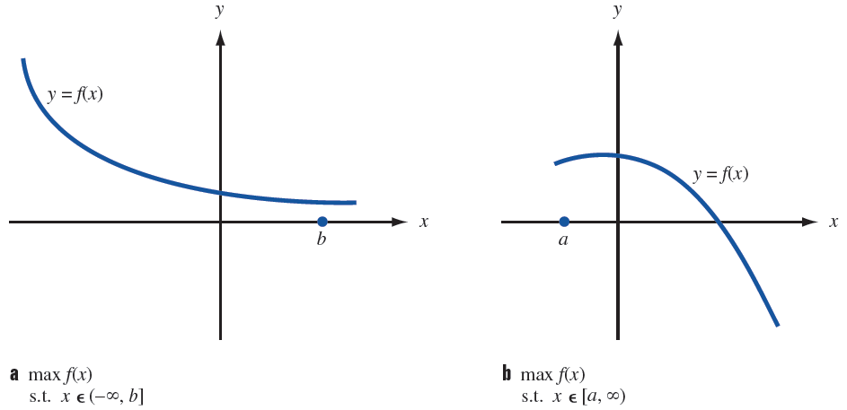
Solving NLP with 1 variable
Solve NLP: max (min) f(x) s.t x ∈ [a, b]
If a = −∞ or b = ∞, then the NLP may have no optimal solution.

Slide 29
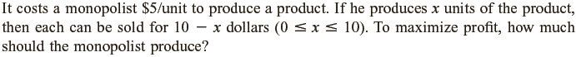
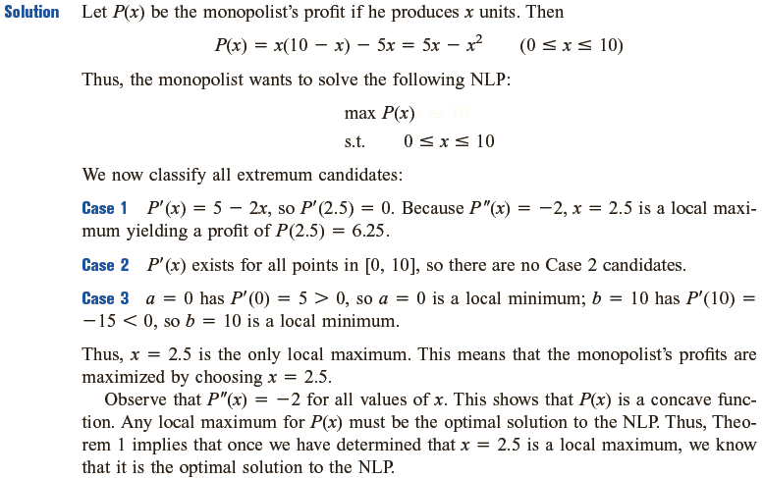

Slide 30


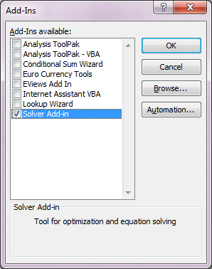
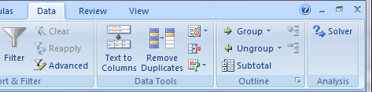
Solving NLPs with Excel
Add in Excel Solver:
Microsoft office File Tab → Options → Add-ins → Manage box → Excel Add-ins → Go
Add-ins available box → Solver Add-in → Ok
Data Tab → Analysis Group → Solver

Slide 31
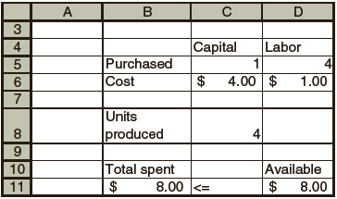
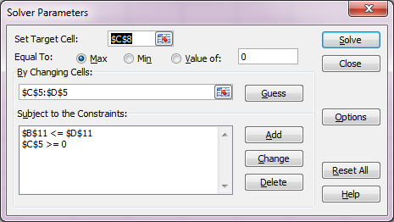
Solving NLPs with Excel

Slide 32
Solving NLPs with Excel
Examples
Lab

Slide 33
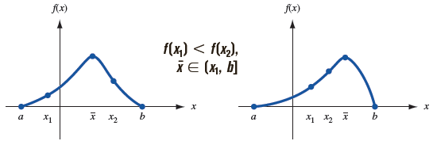
Golden Section Search
If f '(x) doesn’t exist or
Difficult to solve f '(x) = 0
If f(x) = unimodal fn [only 1 local max]
CASE 1
Interval of uncertainty
Notes:
f (x₁) < f (x₂). Because f (x) is increasing for at least part of the interval [x₁, x₂], the fact that f (x) is unimodal shows that the optimal solution to NLP cannot occur on [a, x₁]. Thus, in Case 1, xbar ∈ (x₁, b].
The interval in which xbar must lie is called the interval of uncertainty.

Slide 34
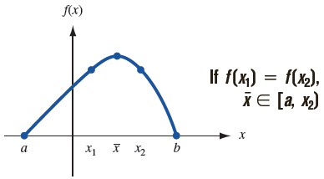
Golden Section Search
If f '(x) doesn’t exist or
Difficult to solve f '(x) = 0
If f(x) = unimodal fn [only 1 local max]
CASE 2
Interval of uncertainty
Notes:
f (x₁) = f (x₂). For some part of the interval [x₁, x₂], f (x) must be decreasing, and the optimal solution to NLP must occur for some xbar < x₂. Thus, in Case 2, xbar ∈ [a, x₂).
The interval in which xbar must lie is called the interval of uncertainty.

Slide 35
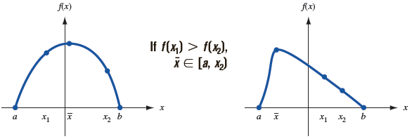
Golden Section Search
If f '(x) doesn’t exist or
Difficult to solve f '(x) = 0
If f(x) = unimodal fn [only 1 local max]
CASE 3
Interval of uncertainty
Notes:
f (x₁) > f (x₂). In this case, f (x) begins decreasing before x reaches x₂. Thus, xbar ∈ [a, x₂).
The interval in which xbar must lie is called the interval of uncertainty.

Slide 36
Golden Section Search
[unimodal function f (x)] When two new points are chosen at Step 3, one will always coincide with a point at which we have previously evaluated f (x).
Steps to reduce interval of uncertainty:
S1: Begin with the region of uncertainty for x being [a, b]. Evaluate f (x) at two judiciously chosen points x₁ and x₂.
S2: Determine which of Cases 1–3 holds, and find a reduced interval of uncertainty.
S3: Evaluate f (x) at two new points (the algorithm specifies how the two new points are chosen). Return to S2 unless the length of the interval of uncertainty is sufficiently small.

Slide 37
Golden Section Search
Move:
New Left-Hand Point : Move a distance equal to a fraction r of the current interval of uncertainty from the right endpoint of the interval of uncertainty.
New Right-Hand Point : Move a distance equal to a fraction r of the current interval of uncertainty from the left endpoint of the interval.
Notes:
Each time f (x) is evaluated at two points and the interval of uncertainty is reduced, we say that an iteration of Golden Section Search has been completed

Slide 38
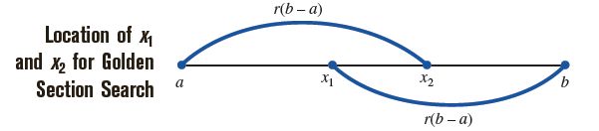
Golden Section Search
Notes:
x₃ =new left-hand point =b−r(b −x₁) =b −r²(b −a)
x₄ =new right-hand point =x₁ +r(b −x₁)
The new left-hand point, x₃, will equal the old right-hand point, x₂.
Use r² =1 − r, x₃ = b +r²(b −a) = b − (1−r)(b −a) =a +r(b −a) =x₂.

Slide 39
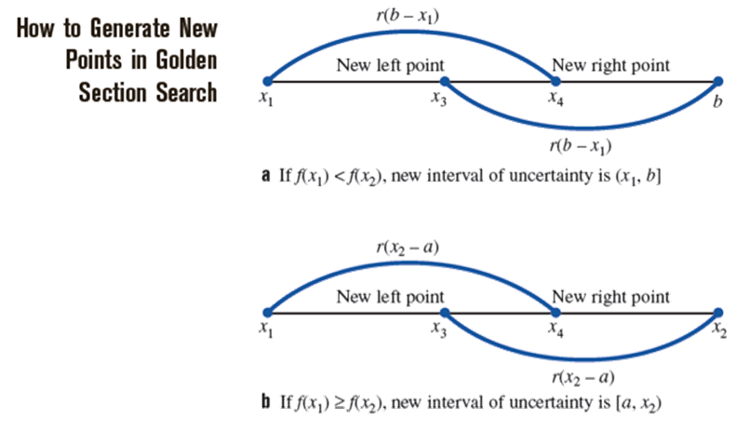
Golden Section Search
Algorithm for CASE 1: f (x₁) < f (x₂)
✓
If f (x₁) < f (x₂), new interval of uncertainty is (x₁, b]
Notes:
x₃ =new left-hand point =b−r(b −x₁) =b −r²(b −a)
x₄ =new right-hand point =x₁ +r(b −x₁)
The new left-hand point, x₃, will equal the old right-hand point, x₂.
Use r² =1 − r, x₃ = b +r²(b −a) = b − (1−r)(b −a) =a +r(b −a) =x₂.

Slide 40
Golden Section Search
Algorithm for CASE 2 & 3: f (x₁) ≥ f (x₂)
✓
If f (x₁) > f (x₂), new interval of uncertainty is [a, x₂)
Notes:
x₃ =new left-hand point =x₂−r(x₂−a)
x₄ =new right-hand point =a +r(x₂−a) =a +r²(b −a)
The new right-hand point, x₄, will equal the old left-hand point, x₁.
Use r² =1 − r, x₄ = a +r²(b −a) = a + (1−r)(b −a)=b −r(b −a) =x₁.
Now the values of f (x₃) and f (x₄) can be used to further reduce the length of the interval of uncertainty. At this point, two iterations of Golden Section Search have been completed.

Slide 41
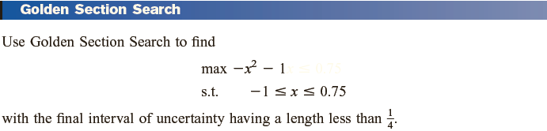
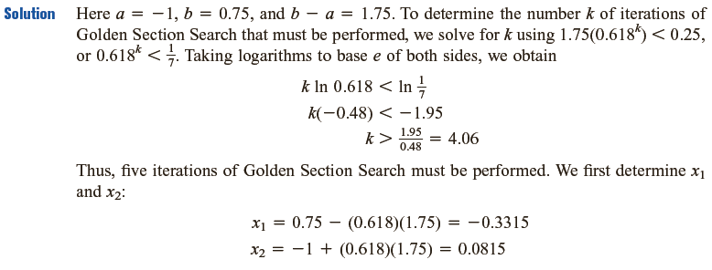


Slide 42
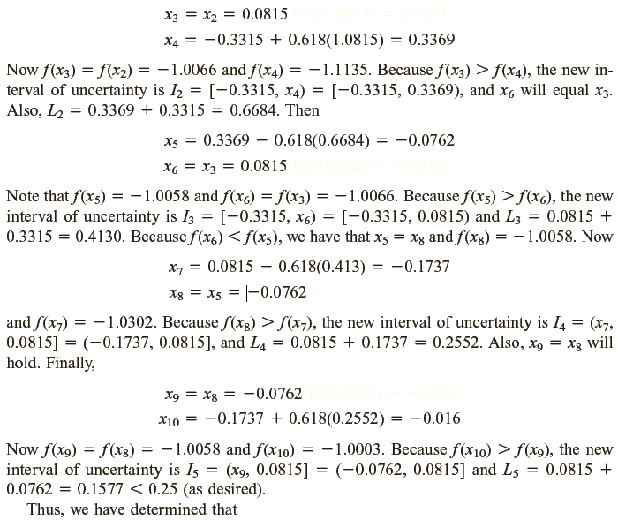
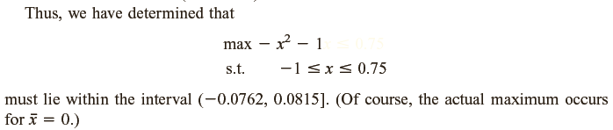

Slide 43
Golden Section Search
Example (using Excel)
max −x² − 1 s.t. −1 ≤ x ≤ 0.75
with the final interval of uncertainty having a length less than 0.25.
a = −1, b = 0.75, b – a = 1.75
Determine k iteration: r^{k} (b – a) < 0.25
(0.618^{k}) (1.75) < 0.25 [r² + r = 1]
k ln 0.618 < ln (0.25÷1.75)
k > 4.0625

Slide 44
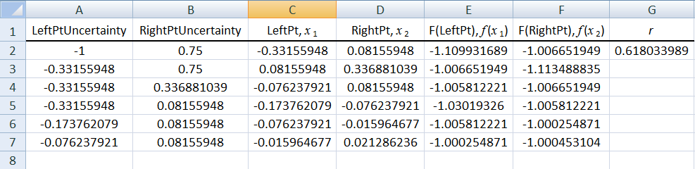
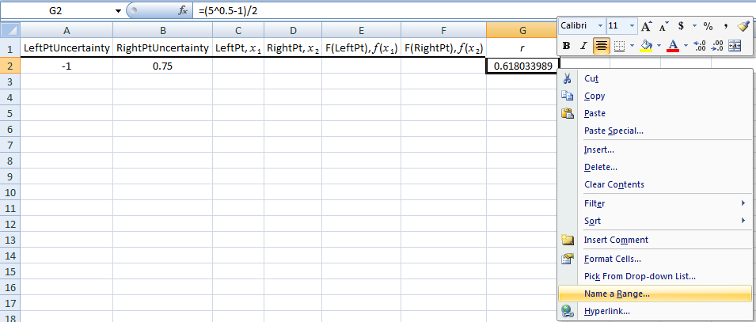
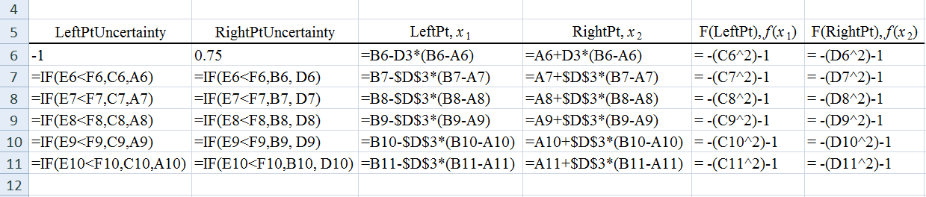
Golden Section Search
Example (using Excel)
max −x² − 1, s.t. −1 ≤ x ≤ 0.75, final interval< 0.25.

Slide 45
Solve NLP with several variables (Unconstrained)
Max z = f (x₁, x₂, …, x_{n}) s.t. (x₁, x₂, …, x_{n}) ∈ R^{n}
Assume 1st & 2nd order partial derivative exist, continuous at all points.
If is a local extremum for unimodal fn, then
If H_{k}(x)>0, k =1, 2, . . . , n, then a stationary point is a local min for NLP z = f (x₁, x₂, …, x_{n}).
k =1, 2, . . . , n, H_{k}( ) ≠ 0, and has the same sign as (−1)^{k}, then a stationary point is a local max.
Hessian fn
Stationary point
H₁>0, H₂>0, ….. ∴ local minimum
H₁<0, H₂>0, H₃<0….. ∴ local maximum

Slide 46
Solve NLP with several variables (Unconstrained)
Example:
A monopolist producing a single product has two types of customers. If q₁ units are produced for customer 1, then customer 1 is willing to pay a price of 70 − 4q₁ dollars.
If q₂ units are produced for customer 2, then customer 2 is willing to pay a price of 150 − 15q₂ dollars.
For q > 0, the cost of manufacturing q units is 100 + 15q dollars. To maximize profit, how much should the monopolist sell to each customer?

Slide 47
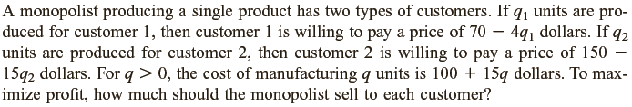
max
f (q₁, q₂) = q₁(70 − 4q₁) + q₂(150 − 15q₂) − 100 − 15q₁ − 15q₂
Find stationary points and 2nd order partial derivatives:
1st Minor = −8 and −30, both < 0
1st Minor < 0,
2nd Minor > 0, ⇒ max function
2nd Minor = (−8)(−30) − 0 = 240 >0

Slide 48
Steepest Ascent
Approximate function’s stationary point.
Also called gradient search
Vector x = (x₁, x₂, …, x_{n}) ∈ R^{n}
Length,
Normalized: [to find unit vector]
Gradient vector:
Direction: d =

Slide 49
Steepest Ascent
Steps:
Given point v₀
Define gradient vector ∇f(x)
Calc direction d = ∇f(v_{i})
Move v with small distance δ in direction d. New point: v_{i+1} = v_{i} + t_{i}∇f (v_{i})
Terminate when ‖∇f (v_{i})‖ < certain value
else
Go back step 4.
or sufficiently close to 0
Solve by line search such as Golden Section Search
Notes:
The rate at which f (x) increases is maximized if (infinitesimal) changes in x are in the direction of the gradient ∇f (x)

Slide 50
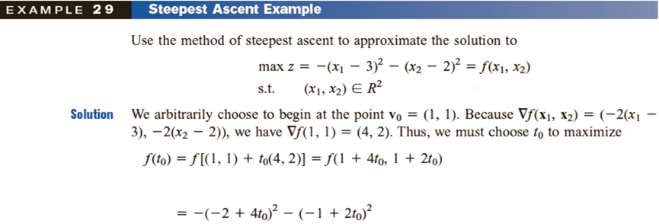
Any start point, v₀ = (1 , 1)
∇f (x₁, x₂) = [− 2(x₁ − 3), − 2(x₂ − 2)]
∇f (v₀) = ∇f (1 , 1) = [− 2(1 − 3), − 2(1 − 2)] = (4, 2)
Max f (t₀) = f [ v₀ + t₀ ∇f (v₀)]
= f [(1 , 1) + t₀(4 , 2)] = f (1 + 4t₀ , 1 + 2t₀)
= −[(1+ 4t₀) − 3]² – [(1 + 2t₀) −2]²
= − (− 2 + 4t₀)² − (− 1 + 2t₀)²
f '(t₀) = − 2(− 2 + 4t₀)(4) − 2(− 1 + 2t₀)(2) = 0
16 − 32t₀ + 4 − 8t₀ = 0
20 – 40 t₀ = 0
t₀ = 0.5
set
Continue…

Slide 51
Steepest Ascent
Example: [Unconstrained NLP]
Max z = f (x₁, x₂)= −(x₁ − 3)² −(x₂ − 2)²
s.t. (x₁, x₂) ∈ R²
t₀ = 0.5,
New point, v₁ = v₀ + t₀ ∇f (v₀)
= (1, 1) + 0.5(4, 2) = (3, 2)
∇f (x₁, x₂) = [− 2(x₁ − 3), − 2(x₂ − 2)]
∇f (3, 2) = [− 2(3 − 3), − 2(2 − 2)] = (0, 0)
Optimal Solution

Slide 52
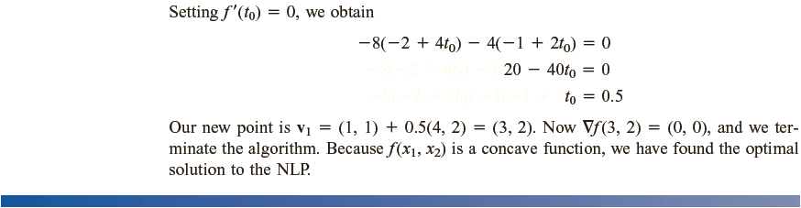
= −[(1+ 4t₀) − 3]² – [(1 + 2t₀) −2]²
f '(t₀) = −2(− 2 + 4t₀)(4) – 2(− 1 + 2t₀)(2) = − 8(− 2 + 4t₀) – 4(− 1 + 2t₀)

Slide 53
NLP with constraints

Slide 54
Lagrange Multipliers
to solve NLPs involve all equality constraints.
max (or min) z = f(x₁, x₂,…, x_{n})
s.t. g₁(x₁, x₂,…, x_{n}) =b₁
g₂(x₁, x₂,…, x_{n}) = b₂
⁞
g_{m}(x₁, x₂,…, x_{n}) = b_{m}
add multiplier λ_{i} and form the Lagrangian:
L(x₁, x₂, . . . , x_{n}, λ₁, λ₂, . . . , λ_{m})
= f (x₁, x₂, . . . , x_{n}) + λ_{i}[b_{i} − g_{i}(x₁, x₂, . . . , x_{n})]
Notes:
If inequality constraints are present, to be able to apply the Lagrange multiplier method we first transform the inequality constraints to equality constraints by adding slack variables:
g_{j}(x) ≤ 0 → g_{j}(x) – t²_{j} = 0
Number of λ depends on number of constraint

Slide 55
Lagrange Multipliers
Minimization problem:
f(x₁, x₂, …, x_{n}) convex, each g_{t} (x₁, x₂, …, x_{n}) linear fn
Maximization problem:
f(x₁, x₂, …, x_{n}) concave, each g_{t} (x₁, x₂, …, x_{n}) linear fn
Any point satisfies these partial derivative with respect to λ_{i}
will be the optimal solution.

Slide 56
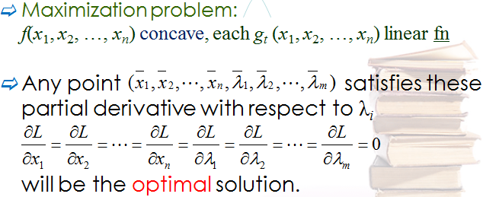
Lagrange Multipliers
Example: max z = − 2x² − y² + xy + 8x + 3y
s.t. 3x + y = 10
L(x, y, λ) = −2x² − y² + xy + 8x + 3y + λ(10 − 3x − y)
Sub into each other
Optimal Solution
Same as
spending an extra small Δ would increase the firm’s revenues by approximately RM0.25Δ
Concave Function, Linear Constraint
∴ Optimal solution obtained!
Check:
H₂(x, y) = (−4)(−2) – 1(1) =7 > 0
1st order principle minor is −ve
Notes:
f (x, y) is concave. The constraint is linear, so Theorem 8 shows that the Lagrange multiplier method does yield the optimal solution to the NLP.
Alternative way: Applicable when have only 1 constraint
f ’(x) = λg ’(x) f ’(y) = λg ’(y)
−4x + y + 8 = 3λ −2y + x + 3 = λ
y = 3λ + 4x – 8 x = λ + 2y − 3
Sub one into another (to remove x term or y term in each eqn):
y = 3λ + 4(λ + 2y − 3) – 8 x = λ + 2(3λ + 4x – 8) − 3
= 3λ + 4λ + 8y − 12 – 8 = λ + 6λ + 8x – 16 − 3
7y = 20 − 7λ 7x =19 – 7λ
y = 20/7− λ x =19/7 – λ
Sub x and y into constraint eqn:
3(19/7 – λ) + (20/7 – λ) = 10
Solve: obtained λ = ¼
Sub λ into eqn y and x:
y = 20/7− ¼ x =19/7 – ¼
= 73/28 = 69/28

Slide 57
Karush-Kuhn-Tucker Conditions
Modification from Lagrange Multiplier.
To be an optimal solution, has to fulfill necessary and sufficient conditions, satisfying all the constraints in NLP.
Constraints for a NLP problem, has to fulfill regular conditions (also called constraint qualification).

Slide 58






Karush-Kuhn-Tucker Conditions
Problem | Necessary Conditions for Optimality | Also Sufficient if:
One variable unconstrained |  | f(x) concave
Multivariable unconstrained |  | f(x) concave
Constrained, nonnegativity constraint only | (or ≤ 0 if x_{j} = 0) | f(x) concave
General constrained problem | Kuhn-Tucker Conditions | f(x) concave and g_{i}(x) convex (i=1,2,…m)

Slide 59
Karush-Kuhn-Tucker Conditions
max (or min) z = f(x₁, x₂,…, x_{n})
s.t. g₁(x₁, x₂,…, x_{n}) ≤ b₁
g₂(x₁, x₂,…, x_{n}) ≤ b₂
⁞
g_{m}(x₁, x₂,…, x_{n}) ≤ b_{m}
How if it’s not “ ≤ ” ??
h(x₁, x₂,…, x_{n}) ≥ b → −h(x₁, x₂,…, x_{n}) ≤ −b
h(x₁, x₂,…, x_{n}) = b → h(x₁, x₂,…, x_{n}) ≤ b, h(x₁, x₂,…, x_{n}) ≥ b
−h(x₁, x₂,…, x_{n}) ≤ −b
must

Slide 60
Karush-Kuhn-Tucker Conditions
Example:
max (or min) z = f(x₁, x₂,…, x_{n})
s.t. g₁(x₁, x₂,…, x_{n}) ≤ b₁
g₂(x₁, x₂,…, x_{n}) ≤ b₂
⁞
g_{m}(x₁, x₂,…, x_{n}) ≤ b_{m}

Slide 61
Karush-Kuhn-Tucker Conditions
Constraints:
g₁(x₁, x₂,…, x_{n}) ≤ b₁
g₂(x₁, x₂,…, x_{n}) ≤ b₂
⁞
g_{m}(x₁, x₂,…, x_{n}) ≤ b_{m}
satisfy
Must satisfy constraint qualifications
Multipliers that must exist and satisfying all the eqn
Maximization
OR
Minimization
Notes:
There must exists multipliers that satisfy all the above eqn
For the theorems to hold, all constraints functions must satisfy certain regularity conditions (constraint qualification)

Slide 62
Karush-Kuhn-Tucker Conditions
Example:
max (or min) z = f(x₁, x₂,…, x_{n})
s.t. g₁(x₁, x₂,…, x_{n}) ≤ b₁
g₂(x₁, x₂,…, x_{n}) ≤ b₂
⁞
g_{m}(x₁, x₂,…, x_{n}) ≤ b_{m}
−x₁ ≤ 0
−x₂ ≤ 0
⁞
−x_{n} ≤ 0
Non-negative variables
x ≥ 0, but K-T conditions, use constraints with ≤

Slide 63
Karush-Kuhn-Tucker Conditions
Constraints:
g₁(x₁, x₂,…, x_{n}) ≤ b₁
g₂(x₁, x₂,…, x_{n}) ≤ b₂
⁞
g_{m}(x₁, x₂,…, x_{n}) ≤ b_{m}
−x₁ ≤ 0
−x₂ ≤ 0
⁞
−x_{n} ≤ 0
satisfy
− for max
+ for min
max
OR
min
Notes:
There must exists multipliers that satisfy all the above eqn
For the theorems to hold, all constraints functions must satisfy certain regularity conditions (constraint qualification)

Slide 64
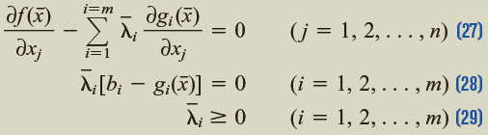

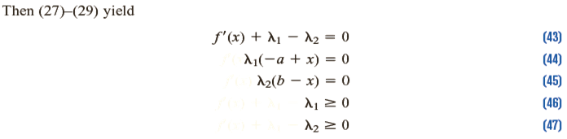
Karush-Kuhn-Tucker Conditions

Slide 65




Slide 66


Slide 67
Karush-Kuhn-Tucker Conditions
Constraint qualification:
Linear Independence Constraint Qualification
Let x be an optimal solution to NLP (with “≤” constraints). If all g_{i} are continuous, and the gradients of all binding constraints (including any binding non-negativity constraints on x₁, x₂, . . . , x_{n}) at x form a set of linearly independent vectors, then the Kuhn–Tucker conditions must hold at x.
Notes:
Kuhn–Tucker conditions may fail to hold at x if the a constraint qualification or regularity condition is not satisfied at an optimal point x.
If the Linear Independence Constraint Qualification fails to hold, then the Kuhn–Tucker conditions may fail to hold at the optimal solution to an NLP.

Slide 68


Slide 69
Quadratic Programming Problem
Linear constraint
Quadratic objective function
Wolfe’s method
Also called modified simplex method
All variables must be non-negative, x_{i} ≥ 0
Notes:
the only difference between quadratic programming problem and a linear programming problem is that some of the terms in the objective function involve the square of a variable or the product of two variables.

Slide 70
Quadratic Programming Problem
min z = −x₁− x₂+ − x₁ x₂
s.t. x₁ + x₂ ≤ 3
−2x₁ − 3x₂ ≤ −6
x₁, x₂ ≥ 0
x₁ − 1 − x₂ + λ₁ − 2λ₂ − e₁ = 0
2x₂ − 1 − x₁ + λ₁ − 3λ₂ − e₂ = 0
x₁ + x₂ + s'₁ = 3
2x₁ + 3x₂ − e'₂ = 6
e₁x₁ = 0, e₂x₂ = 0, λ₁s'₁ = 0, λ₂e'₂ = 0
or
λ₂e'₂ + λ₁s'₁ + e₁x₁ + e₂x₂ = 0
KKT conditions:
− 1 + x₁ − x₂ + λ₁ − 2λ₂ ≥ 0
− 1+ 2x₂ − x₁ + λ₁ − 3λ₂ ≥0
x₁ + x₂ ≤ 3
2x₁ + 3x₂ ≥ 6
Excess variables
Slack variables
Complementary slackness conditions
Can’t be both positive, either 1 be 0, another > 0
Notes:
Complementary slackness cond: ei frm xi constraint and xi cannot be both positive
: slack or excess var for ith constraint and λi cannot be both positive
Never perform a pivot that would make the e_{i} from the i^{th} constraint in (36')
and x_{i} both basic variables.
Never perform a pivot that would make the slack (or excess) variable for the i^{th} constraint and i both basic variables.

Slide 71






Have obvious basic variable, don’t need to add artificial variable
W
W
W
λ₁
a₁
a₁
x₂
x₂
a₂
e₂'
s₁'
s₁'
x₁
x₁
a₂'
W
W
a₁
a₁
x₂
x₂
e₂'
s₁'
x₁
a₂'

Slide 72
Separable Programming Problem
A special case of convex programming with assumption:
f(x) is a concave function.
Each g_{i}(x) is convex function.
f(x) and g_{i}(x) function are separable function.
Max (or min)
s.t.
Approximate each by
Piecewise linear function

Slide 73
Separable Programming Problem
Example:
Oilco must determine how many barrels of oil to extract during each of the next two years.
If Oilco extracts x₁ million barrels during year 1, each barrel can be sold for $30 − x₁. If Oilco extracts x₂ million barrels during year 2, each barrel can be sold for $35 − x₂.
The cost of extracting x₁ million barrels during year 1 is million dollars, and the cost of extracting x₂ million barrels during year 2 is million dollars.
A total of 20 million barrels of oil are available, and at most $250 million can be spent on extraction.
Formulate an NLP to help Oilco maximize profits for the next two years.

Slide 74
Separable Programming Problem
Example:
Max
s.t.
x₁ + x₂ ≤ 20
x₁ , x₂ ≥ 0
Separable programming problem with:
Convex function
Concave function
Notes:
we may use the simplex and ignore the restricted entry rule. The optimal solution to the approximating problem for the problem is δ₁₂ = δ₂₂ = 1. This yields x₁ = 1(5) = 5, x₂ = 1(5) = 5, ẑ = 200.
Compare this with the actual optimal solution to the previous example, which is x₁=7.5, x₂ = 5.83, z = 214.58.

Slide 75



Slide 76


(12) = δ f (10) + (1 – δ) f (15)
12 = δ (10) + (1 – δ)(15)
12 = 10δ + 15 – 15δ
5δ = 3
δ = 0.6
(12) = 0.6f (10) + 0.4f (15)
= 0.6(100) + 0.4(0)
= 60
12

Slide 77


Bad accuracy:
(12) = δ f (0) + (1 – δ) f (20)
12 = δ (0) + (1 – δ)(20)
12 =20 – 20δ
20δ = 8
δ = 0.4
(12) = 0.4f (0) + 0.6f (20)
= 0.4(0) + 0.6(−200)
= −120

Slide 78

δ_{i2}
δ_{i4}
g₂₁(x₁) = x₁
g₂₂(x₂) = x₂
0
5
10
15
20

Slide 79


Notes:
At first glance, the approximating problem may appear to be a linear programming problem. If we attempt to solve the approximating problem by the simplex, however, we may violate the adjacency assumption. To avoid this difficulty, we solve approximating problems via the simplex algorithm with the following restricted entry rule:
If, for a given j all δ_{j,k} =0, then any δ_{j,k} may enter the basis.
If, for a given j, a single δ_{j,k} (say, δ_{j,k'} ) is positive, then δ_{j,k '−1} or δ_{j,k‘+1} may enter the basis, but no other δ_{j,k} may enter the basis.
If, for a given j, two δ_{j,k} ’s are positive, then no other δ_{j,k} can enter the basis.
There are two situations in which solving the approximating problem via the ordinary simplex will yield a solution that automatically satisfies the adjacency assumption. If the separable programming problem is a maximization problem, then each f_{j}(x_{j}) is concave, and each g_{ij} (x_{j}) is convex, then any solution to the approximating problem obtained via the ordinary simplex will automatically satisfy the adjacency assumption. Also, if the separable programming problem is a minimization problem, each f_{j}(x_{j}) is convex, and each g_{ij} (x_{j}) is convex, then any solution to the approximating problem obtained via the ordinary simplex will automatically satisfy the adjacency assumption. Problem 3 at the end of this section indicates why this is the case.
In these two special cases, it can also be shown that as the maximum value of the distance between two adjacent grid points approaches zero, the optimal solution to the approximating problem approaches the optimal solution to the separable programming problem.

Slide 80
Separable Programming Problem
Solve using simplex method, with restricted entry rule:
For a given j if all δ_{j,k} = 0, then any δ_{j,k} can enter the basis.
For a given j a single δ_{j,k'} > 0, then δ_{j,k'−1} or δ_{j,k'+1} can enter basis, no other δ_{j,k} can enter basis.
For a given j, two δ_{j,k}’s are positive, then no other δ_{j,k} can enter.
max f(x) = concave or min f(x) = convex
g(x) = convex g(x) = convex
simply apply ordinary simplex method and ignore the restricted entry rule.

Slide 81
Feasible Direction Method
Modification of steepest ascent
Used to solve linear constraints
max z = f (x)
s.t. Ax ≤ b
x ≥ 0
x = [x₁, x₂, . . . , x_{n}]^{T}
0 is an n-dimensional column vector
Properties of direction:
when move away from x⁰,
Remain feasible
Increase value of z
Concave function
m × n matrix

Slide 82

Feasible Direction Method

Slide 83



Slide 84

Feasible Direction Method

Slide 85
Pareto Optimality and Tradeoff Curves
Pareto Optimality:
A solution (call it A) to a multiple-objective problem is Pareto optimal if NO other feasible solution is at least as good as A with respect to every objective (two objs) and strictly better than A with respect to at least one objective.
A feasible solution A dominates a feasible solution B to a multiple-objective problem if A is at least as good as B with respect to every objective and is strictly better than B with respect to at least one objective.
Pareto optimal solutions are the set of all undonimated feasible solutions.

Slide 86


Pareto Optimality and Tradeoff Curves
Trade-off curve:
Also called efficient frontier.
Graph of “score” of all Pareto optimal solutions in x-y plane with x-axis and y-axis being the score on objective 1 and objective 2 respectively.
Notes:
The set of feasible solutions to a multiple-objective problem is the shaded region bounded by the curve AB and the first quadrant. The curve AB is the set of Pareto optimal points.

Slide 87
Pareto Optimality and Tradeoff Curves
Steps:
Choose obj 1 and determine the best value of this obj that can be attained (call it v₁). For the solution attaining v₁, find the value of obj 2 (call it v₂). Then (v₁, v₂) is a point on the trade-off curve.
For values v of obj 2 that are better than v₂, solve the optimization problem in step 1 with the additional constraint: The value of obj 2 is at least as good as v. Varying v (over values of v preferred to v₂) will give you other points on the trade-off curve.
In step 1, we obtained 1 endpoint of the trade-off curve. If we first determine the best value of obj 2 that can be attained, we obtain the other endpoint of the trade-off curve.
Notes:
In situations when there are more than two objectives, it is often helpful to examine trade-off curves between different pairs of objectives

Slide 88




Slide 89




Slide 90
Convex programming
Extra
Convex programming convers a broad class of problems that actually encompasses as special cases all the preceding types when f (x) is a concave function to be maximized.
Assumption :
f (x) is a concave function.
Each g_{i} (x) is a convex function.

Slide 91
Convex Programming Problem
Extra
Wolfe’s method
Initialization: Find a feasible initial trial solution x⁽⁰⁾, set k = 1
Iteration:
Find at x = x^{(k–1)}, set c_{j} = for j = 1, 2, . . . , n
Find optimal soln for LP problem
Max s.t. Ax ≤ b and x ≥ 0
set h(t) = f(x) for 0 ≤ t ≤ 1 &
Stopping rule: If x^{(k−1)} and x^{(k)} are sufficiently close, stop and use x^{(k)} as the estimate of an optimal solution.
Notes:
From McGrawHill book

Slide 92





Slide 93


Slide 94



